Slide 1
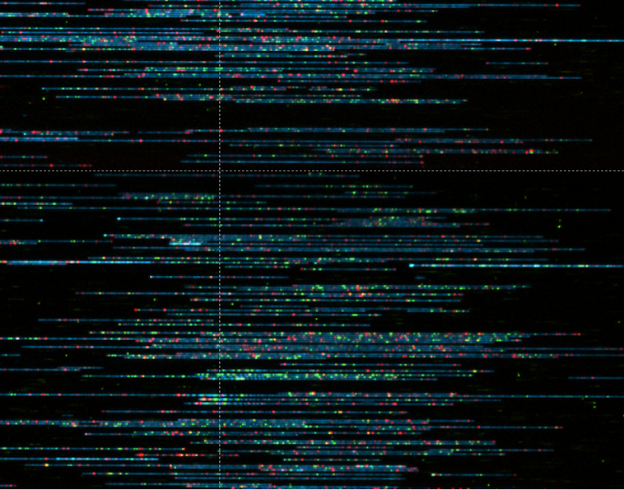
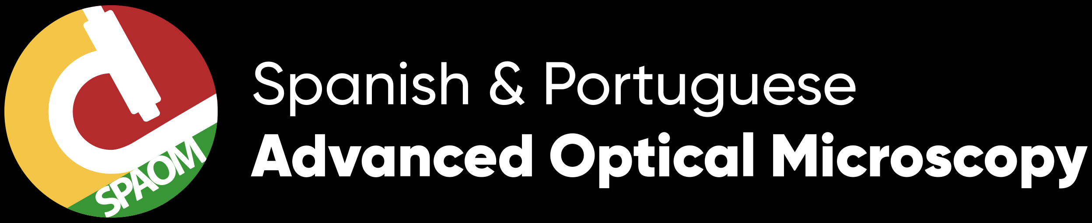


Multi-modal Single-molecule Imaging with
Continuously Controlled Spectral-resolution (CoCoS🌴) Microscopy
we
Jonathan Jeffet
School of Physics and Astronomy
Supervisor: Prof. Yuval Ebenstein
Notes:
Thanks for the organizers for this amazing online conference
I'm Jonathan from the ebenstein's group in Tel aviv University.
And I want to show you in this talk our new system, CoCoS, a new method to see colors ☺

Slide 2
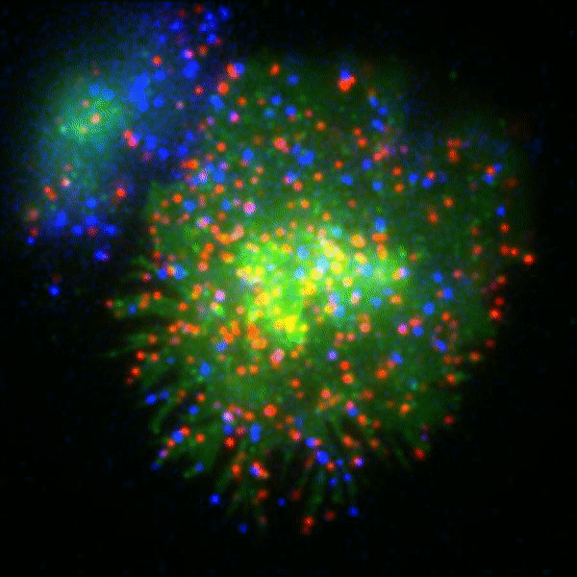
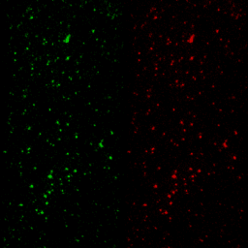
Fluorescence microscopy:
Color as a contrast mechanism
Single molecules interactions
Single molecule Förster Resonance Energy Transfer (smFRET)
Ito, Y. et al., Sci Rep 7, 6994 (2017)
Kalinin, S. et al. Nat Methods 9, 1218–1225 (2012)
Notes:
As a microscopy community, I don’t need to tell you that color is a great contrast mechanism.
1. It enables to distinguish between biological entities in complex environments and to record their dynamics:
Like tracking these different proteins interacting on a cell membrane.
2.Or using color spectroscopy it allows measuring dynamic sub-nanometer distances and characterizing single protein folding using FRET.
So the goal is obviously to see as many colors as we can with good temporal resolution!

Slide 3
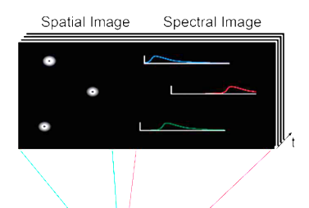
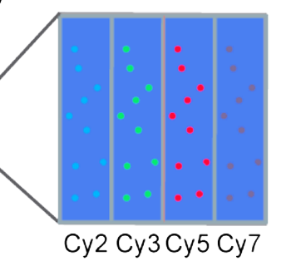
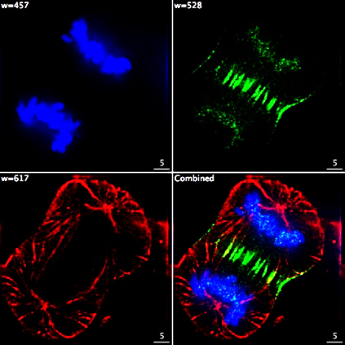
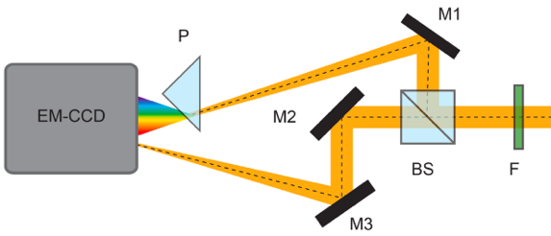
Optical schemes for wide-field color detection
Filter wheel
Color channel
split-view
Spectral split-view
Dispersive element
Slit
Slit
Space
Time
Time
More colors
Time
Space
Space (<20⨉20μm²)
SNR
Zhang, Z. et al., Nat. Methods 12, 935–938 (2015).
Dong, B. et al., Nat. Commun. 7, 1–8 (2016).
Mlodzianoski, M. J. et al., PLoS One 11, 1–12 (2016).
Notes:
To do that there are three main schemes for color detection used today:
1.The common method is to use a filter wheel to switch between emission colors:
So you get a large FOV but you pay with acquisition time, as each color requires another acquisition.
Another huge problem is that each color is imaged at a different time, therefor recording multi-color dynamics is problematic.
2. The second approach is to split the FOV to the different color channels:
With this method you record all colors at the same time but pay with real-estate on your camera reducing the acquisition throughput.
3. The most recent approach is to split the camera into localization and spectral images using a dispersive element.
This allows to record unlimited amount of colors at the same time, but again you pay with space on your camera, and here also with lower photon count as you split them between the two images.
So we searched for a method that get us the best of all worlds.

Slide 4
🌴CoCoS🌴
Optical
Setup
Large FOV
(130⨉130 μm²)
Almost
no photon loss
Simultaneous multi-color acquisition
Simple add-on (maintains optical axis)
CoCoS
5 μm
30 μm
Notes:
So Meet our CoCoS system! ☺
The upper part is just our epi-fluorescence microscope with 5-laser excitation.
The fluorescence image out of the microscope is inserted into our CoCoS add-on which is composed of a telescope and two prisms.
The result is an image recording all colors simultaneously encoding their color into displacement along a single axis.
In this example you see 100nm beads labeled with 5-colors. The dyes spectra is shown at the bottom with the emission filter bands shown in gray.
So you get:
Huge FOV
Almost no photon loss at the prisms
Imaging all colors in a single frame
And it’s a simple add on to any microscope with practically no alignment needed
So let me explain a little about how this works.

Slide 5
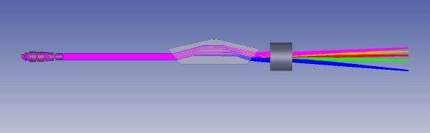
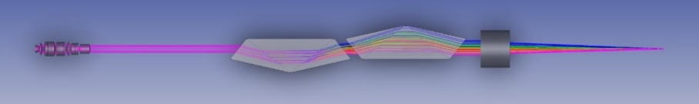
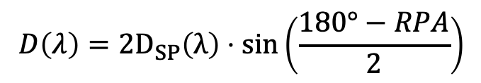
Operation principle
Double Amici prism
(direct vision prism)
Atmospheric chromatic aberration correction in astronomy
$$D\left(λ\right)=2D_{SP}\left(λ\right)⋅sin\left(\frac{180°−RPA}{2}\right)$$
RPA = relative prism angle
Wynne, C. G. & Worswick, S. P., Mon. Not. R. Astron. Soc. 220, 657–670 (1986).
Notes:
The building blocks of CoCoS are these Amici prisms.
In these, the central wavelength is passed straight through while light of shorter or longer wavelengths is dispersed in opposite directions , so it maintains the optical axis.
But a single prism creates too much dispersion.
Luckily many of the optical problems that we’re facing in bio-imaging, were once solved by astronomers ☺
If you take two prisms instead of one, and rotate them relative to one another by 180 degrees you can cancel the dispersion completely.
Varying the relative angle (or RPA as we call it), creates a continuous control over the dispersion following this equation.

Slide 6

Continuously Controlling Spectral-resolution (CoCoS)
SNR & Throughput
Spectral-resolution
0.5 s
Three CoCoS modalities:
Localization (no dispersion)
Color detection (minimal dispersion)
Spectroscopy (fully detailed spectra)
Notes:
So here is an example. This is a single 100nm Silica bead stained with 4 dyes.
Changing the relative prism angle using motorized rotators, allows a continuous control over the spectral resolution in under half a second: from fully canceled localization image to dispersed image where the spectral signature of the dyes is apparent.
This also shows the compromise between Spectral resolution and SNR and throughput. Better resolution means lower SNR and more camera real-estate taken by a single bead.
This continuous dispersion control allows us to toggle with a press of a button between Localization, simple color detection where the different colors are just resolvable with highest SNR and full spectral information.

Slide 7
Continuously Controlling Spectral-resolution (CoCoS)
Choosing the ideal spectral-resolution for color detection:
Notes:
This tunability allows to adjust the spectral resolution per experiment, fitting it to the sample used and the fluorophores needed to be resolved.
Closer spectra=Lower RPA = larger dispersion

Slide 8
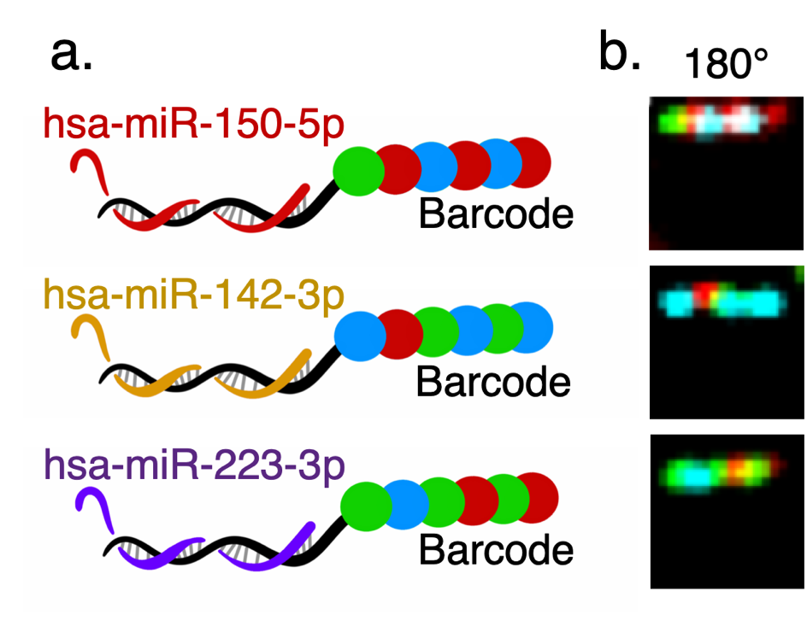
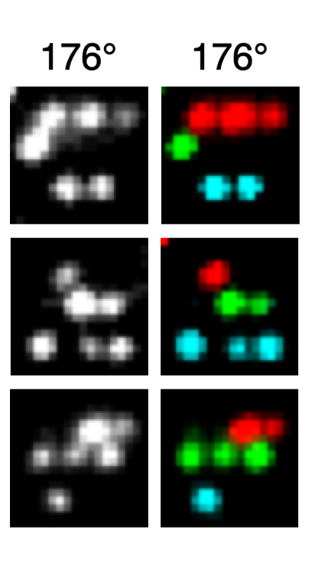
Application 1: Color detection
Single microRNA identification using 4-color NanoString barcodes
NanoString sequential acquisition
CoCoS
single snapshot matrix decoding
In collaboration with the Shomron lab
Notes:
So let me show you that it works ☺
The first application is showing color-detection with these NanoString barcodes.
NanoStrings are commercial molecular probes designed for RNA expression analysis.
These probes are labeled with 4 colors at 6 different locations, forming a unique barcode for each target RNA molecule.
So the commercial NanoString system enables identification and counting of up to 800 different RNA targets in a single experiment.
Here you can see three NanoString barcodes imaged as they would in the commercial system with 4 consecutive acquisitions.
Now here is how it looks like with CoCoS single-shot acquisition.
The colors are dispersed with the minimal spectral resolution needed to fully resolve the different colors, saving time, space and SNR.

Slide 9
Barcode decoding in a single snapshot
Single-snapshot decoding:
4-fold increased throughput
More colors - No time cost:
>410-fold increase in available barcode combinations
In collaboration with the Shomron lab
Notes:
The CoCoS matrix imaging enables decoding the different barcodes with just a quarter of the acquisition time.
We now can also introduce more colors without any time penalty, which means enabling more than 400-fold increase in available RNA targets.

Slide 10
Application 2: Spectroscopy
Resolving the shades of far-red dyes
(spectral detection with a single laser excitation)
Can we resolve multiple far-red dyes within the same color channel?
Wavelength [nm]
(0.625 s)
Notes:
The second example shows the ability to extract full spectral information with CoCoS.
I wanted to check if we can differentiate between dyes with similar spectra that fall within the same spectral window.
To do that you need two consecutive acquisitions: first you take a non-dispersed image with Relative angle of 180°,next you rotate the prisms to create a dispersed spectral image.
Taking the intensity profile of the molecule in the spectral image and comparing its displacement to the localization image enables to deduce the full spectral information of the molecule.

Slide 11
Notes:
To show this I labeled 100nm beads with 3 far-red dyes and mixed them together.
On the left you can see an overlay of the localization image in white and the spectral image in red, with enlarged examples at panel C.
Using cross-correlation comparison to the theoretical spectra of the different dyes, I could classify each bead to its dye. Full classified FOV shown on the right of panel B.
At the bottom you can see an overlay of all the single bead spectra in the FOV. Showing we can distinguish between molecules with spectral maxima differences of 6 nm!

Slide 12
Future application:
6 targets with a single excitation
<6nm spectral-resolution – full spectral characterization
Reduced phototoxicity for live samples
Reduced optical complexity and costs (single excitation, no chromatic aberrations)
Notes:
And this really expands the color pallet we could use in future applications!
With under 6nm spectral resolution, we now can distinguish between 6 different dyes in a single laser excitation!
This significantly reduces photo-damage and the optical complexity and costs of the system.

Slide 13
Application 3:
Measuring nm distances with smFRET
Donor Ex.
R_{〈E〉}= 54.3±3.8 Å
R_{〈E〉}= 65.8±4.6 Å
Donor Ex.
R_{〈E〉}= 88.4±6.2Å
Donor Ex.
Single molecule sensitivity in Epi-illumination (no TIRF)
>6-fold increase in throughput over standard dual-color smFRET
>4-color smFRET with ultra-high throughput
In collaboration with the Craggs lab
Notes:
The last application I want to show here is the ability to record single molecule FRET on CoCoS.
In FRET when you excite a donor dye, the acceptor can “steal” its emission photons and emit them at longer wavelengths.
The efficiency of this process is highly dependent on the distance between the donor and acceptor dyes, allowing to measure sub-nm distances.
In this experiment, we used synthetic DNA molecules tagged with specifically spaced donor and acceptor dyes, resulting in low, medium and high FRET efficiencies.
In CoCoS, the acceptor emission is dispersed above the donor’s allowing to image their emission simultaneously.
Here you can see example kymographs of 3 FRET pairs, visualizing the dynamic FRET efficiency upon donor excitation. In yellow you see the intensity of acceptor emission in time, and in green the donor’s emission.
Using alternating laser excitation we could accurately quantify the FRET efficiency, and resolve the three distance distributions of the samples.
This shows that we can have single molecule sensitivity with Epi- illumination, and also get a big increase in throughput.
We can now easily do multi-color smFRET and break the current 4-color record.

Slide 14
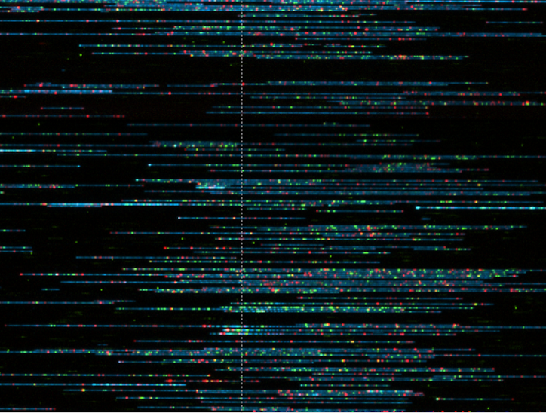
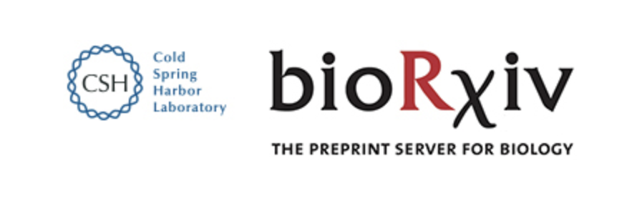
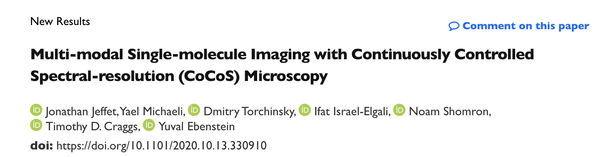

Thanks!
Notes:
All this and more is now available online in bioRxiv.
I would really like to thank all our collaborators that gave us their samples, and Yael and Dima from my lab that helped making this work.

Slide 15
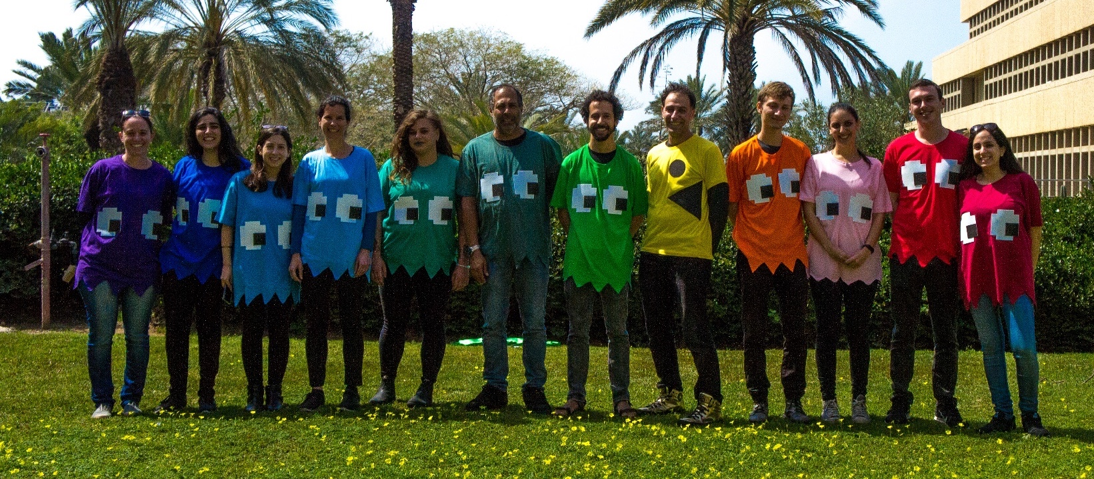
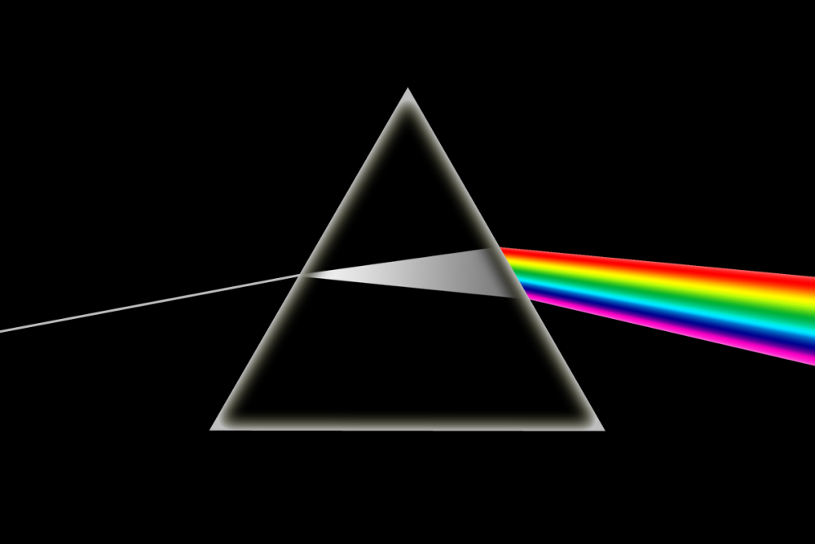
Thanks!
Notes:
And especially to thank Yuval and the great team we have in the lab,
And finally the Azrieli foundation for their generous fellowship
And I’d be happy to take any questions.

Slide 16
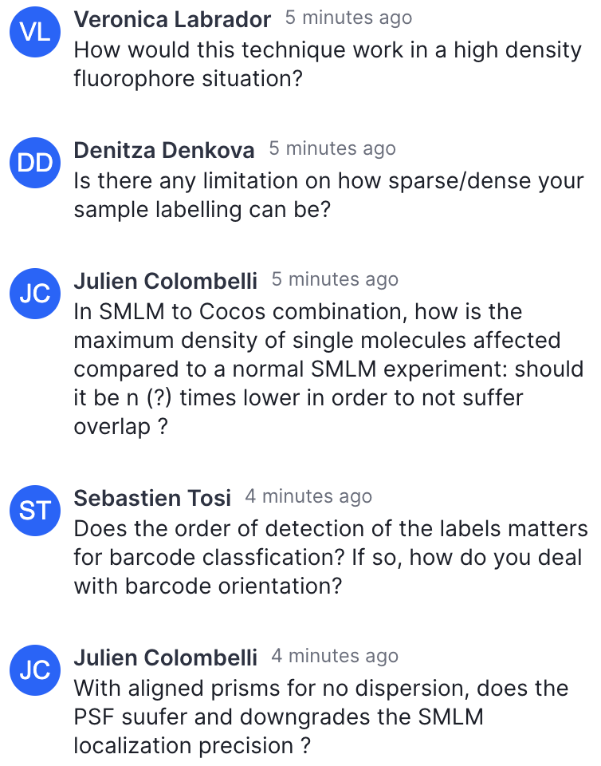

Slide 17
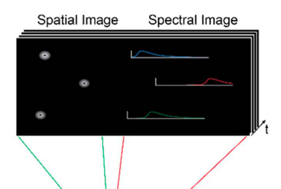
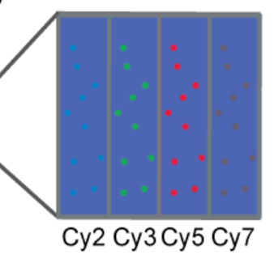
Optical schemes for wide-field color detection
Filter wheel
Color channel
split-view
Spectral split-view
Dispersive element
Slit
Slit
Large FOV
Temporal color channels sync
Temporal color sync
Endless “channels”
Color → Spectrum
Loss of temporal color synchronization
Reduced FOV
Fixed set of
color channels
Smallest FOV (20⨉20μm²)
Photon loss (Low SNR)
Complex alignment
Notes:
In order to do that there are three main schemes for color detection:
The common method is using a filter wheel to switch emission color channels. This allows large FOV but you lose throughput and acquisition synchronization between colors with every additional color. So dynamic recording is problematic with this scheme.
The second approach is to split your FOV to the different colors allowing to record color simultaneously paying this time with real-estate on your camera, thus reducing throughput.
The most recent approach is to split the FOV to a localization and spectral images, allowing to record unlimited number of color channels simultaneously, paying with reduced SNR and very small FOV.

Slide 18
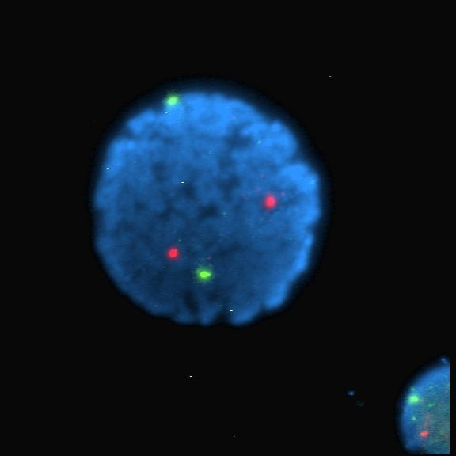
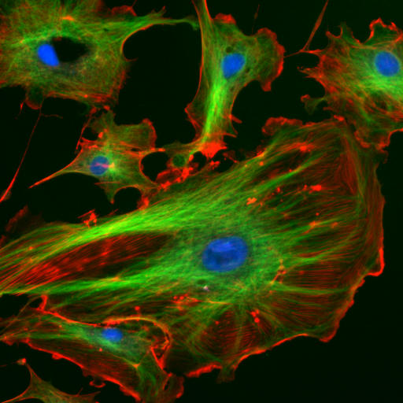
Fluorescence microscopy:
Color as a contrast mechanism
Human lymphocyte nucleus (FISH).
Ch.13 (green) & ch.21 (red) centromeres
Endothelial cells (BPAE).
Nuclei (blue), microtubules (green) & actin filaments (red)
Notes:
Let’s start off with a quick intro to fluorescence microscopy.
We tag the samples with fluorescent molecules.
When excited these molecules emit light slightly shifted towards the red.
This allows to filter out the strong excitation light and collect only the light emitted from these molecules allowing to greatly enhance their contrast.
Different types of fluorophores have different colors, so we can tag many different entities and distinguish between them in complex environments.
Such as different chromosomes in the nucleus, different proteins in the cell or our own interest in the lab: different genetic and epi-genetic modifications on single DNA molecules
But that’s for a different talk…
Human lymphocyte nucleus stained with DAPI with chromosome 13 (green) and 21 (red) centromere probes hybridized (Fluorescent in situ hybridization (FISH))
Endothelial cells under the microscope. Nuclei are stained blue with DAPI, microtubules are marked green by an antibody bound to FITC and actin filaments are labeled red with phalloidin bound to TRITC. Bovine pulmonary artery endothelial (BPAE) cells

Slide 19
Fluorescently recording dynamics
Single particle tracking (SPT)
Single molecule Förster Resonance Energy Transfer (smFRET)
Ito, Y. et al., Sci Rep 7, 6994 (2017). https://doi.org/10.1038/s41598-017-06960-z
Kalinin, S. et al. Nat Methods 9, 1218–1225 (2012). https://doi.org/10.1038/nmeth.2222
Notes:
A major feature of fluorescence microscopy is the ability to see dynamics in live environments.
You can track different proteins moving on membranes to learn their diffusion and characteristics.
And you can also measure dynamically sub-nanometer distances using FRET, and characterize protein folding.
We’ll talk about that later on.
So we want to see as many colors possible and visualize them with good temporal resolution!

Slide 20

Optical schemes for wide-field color detection
Filter wheel
Color channel
split-view
Spectral split-view
Dispersive element
Slit
Slit
Pros & Cons
Notes:
So basically there are three main methods out there to do that:
1. The most common is using filter wheel.
You image the sample with different filters sequentially
and then overlay these images to create a composite color image of your sample.
Advantage: simple and with the largest field of view,
Disadvantages: if dynamics is faster than filter switching you loose synchronization between colors.
And you pay for each additional color with a linear increase in total acquisition time.
2. The second approach is to split the FOV of your camera to different areas each area recording a different color.
Advantages: you image all colors at the same time.
Drawbacks: You pay with smaller FOV that gets smaller and smaller with every color.
3. The last method is quite new.
The emission is split in two: a diffraction limited channel used for localization with no spectral information, and a spectral channel where a dispersive element (prism or grating) is used to give the spectral signature of the fluorescent molecules.
Advantages: almost unlimited number of color channels in a single frame.
Drawbacks: really small FOV.
Hard alignment.
The spectral resolution is set with the assembly of the optical system, I will show you why this is a problem.
Epifluorescent imaging of the three components in a dividing human cancer cell. DNA is stained blue, a protein called INCENP is green, and the microtubules are red. Each fluorophore is imaged separately using a different combination of excitation and emission filters, and the images are captured sequentially using a digital CCD camera, then overlaid to give a complete image.

Slide 21

Optical schemes for wide-field color detection
Filter wheel
Color channel
split-view
Spectral split-view
Dispersive element
Slit
Slit
Large FOV
Temporal color channels sync
Temporal
color sync
Endless “channels”
No temporal color channels sync
Smaller FOV
Fixed color channels
Smallest FOV (20⨉20μm²)
Photon loss
Complex alignment
Notes:
So basically there are three main schemes for color detection out there:
1. The most common is using filter wheel.
You image the sample with different filters sequentially
and then overlay these images to create a composite color image of your sample.
Advantage: simple and with the largest field of view,
Disadvantages: if dynamics is faster than filter switching you loose synchronization between colors.
And you pay for each additional color with a linear increase in total acquisition time.
2. The second approach is to split the FOV of your camera to different areas each area recording a different color.
Advantages: you image all colors at the same time.
Drawbacks: You pay with smaller FOV that gets smaller and smaller with every color.
3. The last method is quite new.
The emission is split in two: a diffraction limited channel used for localization with no spectral information, and a spectral channel where a dispersive element (prism or grating) is used to give the spectral signature of the fluorescent molecules.
Advantages: almost unlimited number of color channels in a single frame.
Drawbacks: really small FOV.
Hard alignment.
The spectral resolution is set with the assembly of the optical system, I will show you why this is a problem.
Epifluorescent imaging of the three components in a dividing human cancer cell. DNA is stained blue, a protein called INCENP is green, and the microtubules are red. Each fluorophore is imaged separately using a different combination of excitation and emission filters, and the images are captured sequentially using a digital CCD camera, then overlaid to give a complete image.

Slide 22
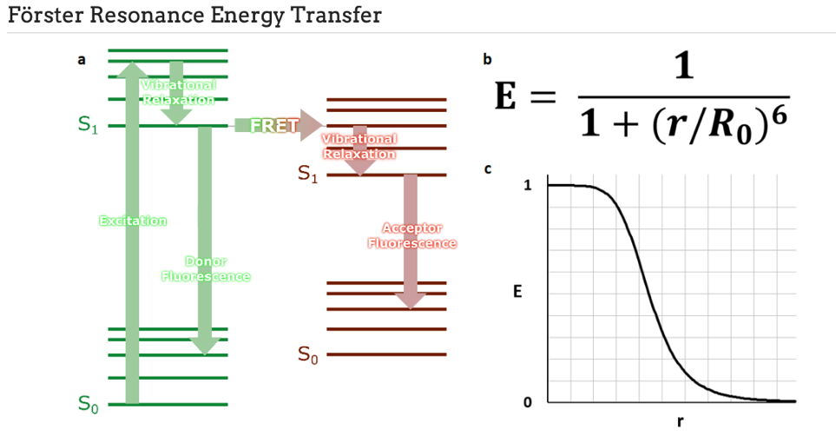
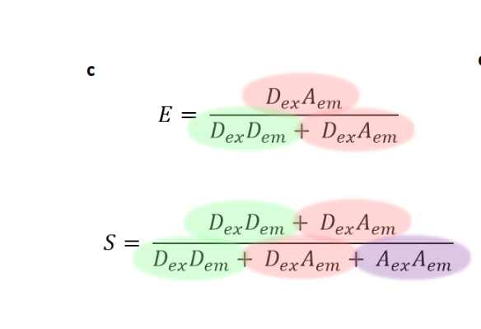
Application 3: Dynamic color detection
Single-molecule Förster
Resonance Energy Transfer (smFRET)
Sub-nm distances “ruler”
No FRET
FRET
FRET efficiency
r [nm]
In collaboration with the Craggs lab
Förster, T. Ann. Phys. 437, 55–75 (1948).
Notes:
The last example I want to show you is measuring single molecule FRET.
FRET is a non-radiative energy transfer process that happens when two fluorophores donor and acceptor with overlapping emission(donor) and excitation (acceptor) spectra are placed in close proximity.
Upon donor excitation, depending on distance the acceptor will “steal” energy from the donor and emits it as photons.
The efficiency of this process allows very accurate measurement of nm scale distances.
Very relevant to dynamic measurements of protein folding and structures.

Slide 23
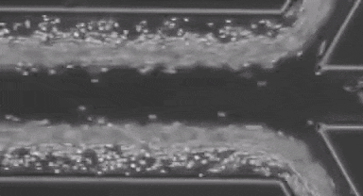

What are we after?
High throughput (wide FOV)
As many colors as possible
Simultaneous acquisition of all colors
Simple to assemble and align
Single molecule sensitivity

Slide 24
Resolving two shades of green
In collaboration with the Shomron lab
Notes:
But the barcodes actually contain 4 colors and not just the red green and blue that I’ve showed you.
Two of these colors fall in the same green channel of our system.
But not to worry, we can resolve these green dyes by increasing the spectral resolution with a click of a button.
On the left you can see the corresponding image taken with sequential excitations and filters fitting the different dyes.

Slide 25
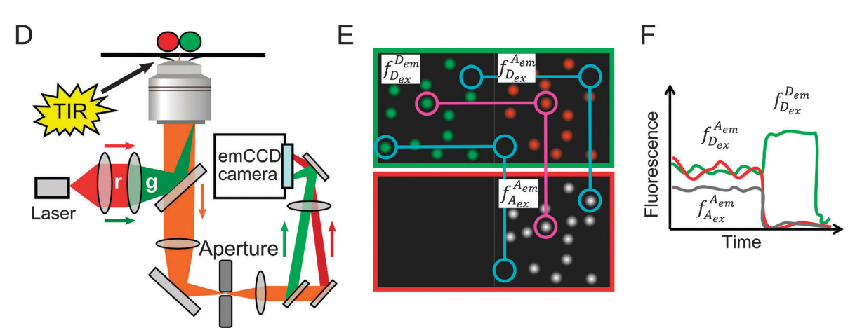
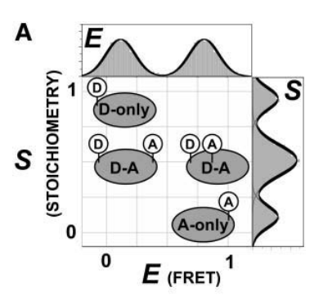
Alternating Laser Excitation (ALEX)
Hohlbein, J., Craggs, T. D. & Cordes, T., Chem. Soc. Rev. 43, 1156–1171 (2014).
In collaboration with the Craggs lab
Lee, N. K. et al., Biophys. J. 88, 2939–2953 (2005).
Notes:
But FRET is prone to errors.
If either the acceptor or donor bleaches then the measurement is inaccurate.
To resolve this Shimon Weiss lab invented ALEX in 2005.
The concept is to alternate donor and acceptor excitation to make sure that both of them are active.
Here you can see the three channels recorded: Donor excitation at the top, with donor emission in green and acceptor emission in red. Acceptor excitation at the bottom with corresponding acceptor emission in gray.
From this you can create FRET time traces and see bleaching events.
So now you have another axis of information that allows determining the FRET efficiency of dye-pairs only in this 2d histogram.
To accurately calculate FRET efficiency and to rule out molecules that either donor or acceptor are not active, the ALEX method was introduces by the Shimon Weiss lab in 2005.
The basic principle is that you alternate between donor and acceptor excitations and register two emission channels simultaneously in each excitation. A channel split view is generally used in these systems.
At the right you can see a FRET pair showing donor emission with donor excitation in green, acceptor emission with donor excitation in red and acceptor emission with acceptor excitation in gray. Note that once the acceptor is bleached the donor is no longer transferring energy to it and its emission gets more intense.
With this FRET scheme one can plot the signals on a 2d histogram and clearly distinguish between single dye species and FRET pairs species.

Slide 26
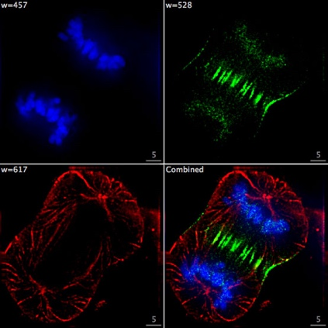
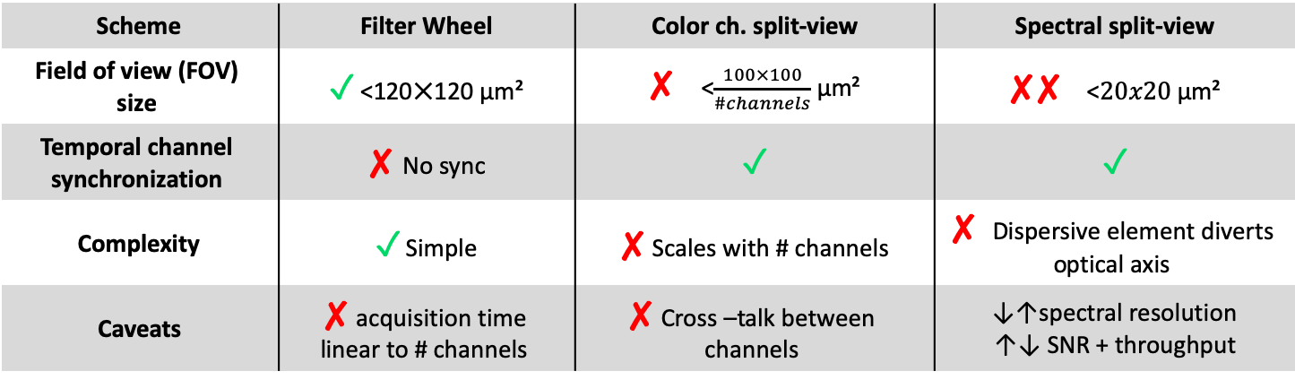
Optical schemes for color detection
Filter wheel
Color channel
split-view
Spectral split-view
Dispersive element
Pros vs. Cons
Scheme | Filter Wheel | Color ch. split-view | Spectral split-view
Field of view (FOV) size | ✓ <120⨉120 μm² | ✘ <$\frac{100×100}{\#channels}$ μm² | ✘✘ <$20x20$ μm²
Temporal channel synchronization | ✘ No sync | ✓ | ✓
Complexity | ✓ Simple | ✘ Scales with # channels | ✘ Dispersive element diverts optical axis
Caveats | ✘ acquisition time linear to # channels | ✘ Cross –talk between channels | ↓↑spectral resolution ↑↓ SNR + throughput
Notes:
Epifluorescent imaging of the three components in a dividing human cancer cell. DNA is stained blue, a protein called INCENP is green, and the microtubules are red. Each fluorophore is imaged separately using a different combination of excitation and emission filters, and the images are captured sequentially using a digital CCD camera, then overlaid to give a complete image.

Slide 27
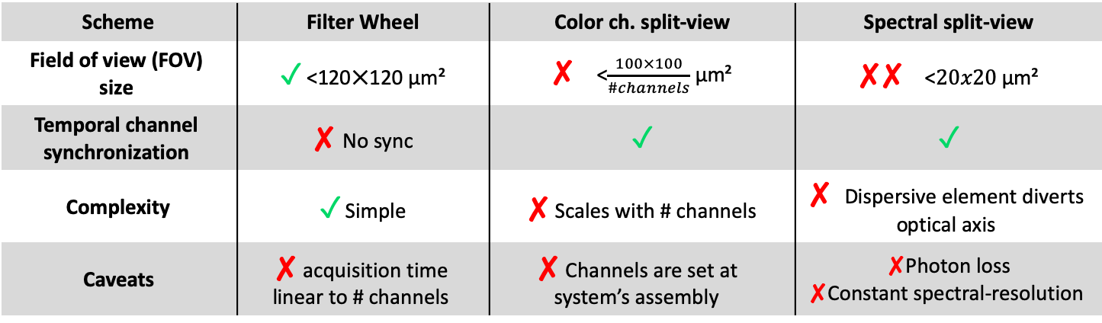
Optical schemes for color detection
Filter wheel
Color channel
split-view
Spectral split-view
Dispersive element
Pros vs. Cons
Scheme | Filter Wheel | Color ch. split-view | Spectral split-view
Field of view (FOV) size | ✓ <120⨉120 μm² | ✘ <$\frac{100×100}{\#channels}$ μm² | ✘✘ <$20x20$ μm²
Temporal channel synchronization | ✘ No sync | ✓ | ✓
Complexity | ✓ Simple | ✘ Scales with # channels | ✘ Dispersive element diverts optical axis
Caveats | ✘ acquisition time linear to # channels | ✘ Channels are set at system’s assembly | ✘Photon loss ✘Constant spectral-resolution
Notes:
Epifluorescent imaging of the three components in a dividing human cancer cell. DNA is stained blue, a protein called INCENP is green, and the microtubules are red. Each fluorophore is imaged separately using a different combination of excitation and emission filters, and the images are captured sequentially using a digital CCD camera, then overlaid to give a complete image.

Slide 28
Optical schemes for color detection
Multi objectives/cameras

